Slide 1
Predicting Food Inspections Failures in Chicago
Final Project: MUSA508
University of Pennsylvania
December 17, 2021
By: William Friedrichs & Sabir Nazarov

Slide 2
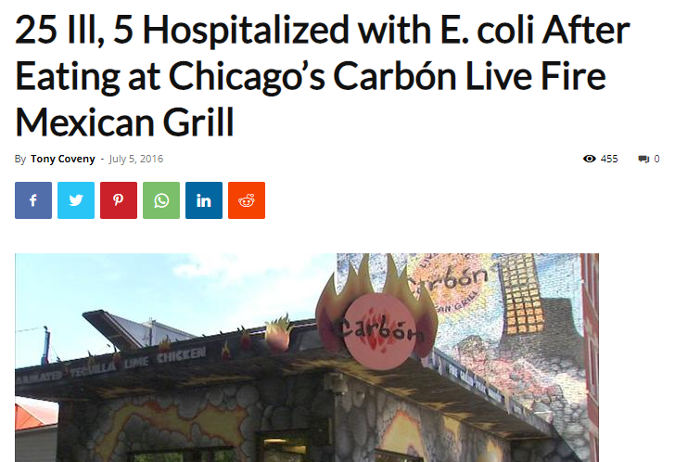
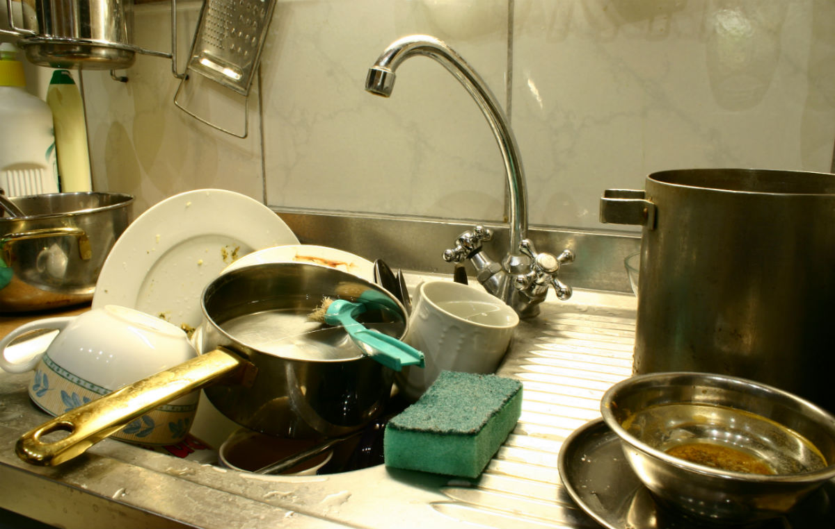
Use Case: Chicago, IL
Our predictive algorithm allows for faster identification of critical violations, increasing public health and safety outcomes.
Notes:
Source: https://chicago.github.io/food-inspections-evaluation/

Slide 3

Target Audience
Municipalities
Departments of Health
City Commissioners
Departments of Sanitation and Services
15,000 food establishments
36 inspectors
417 establishments per inspector

Slide 4

How it’s Used
Choose a year to predict failures
The tool automatically takes in risk factors from Chicago Open Data
Predicting the total number of inspections that will be necessary

Slide 5
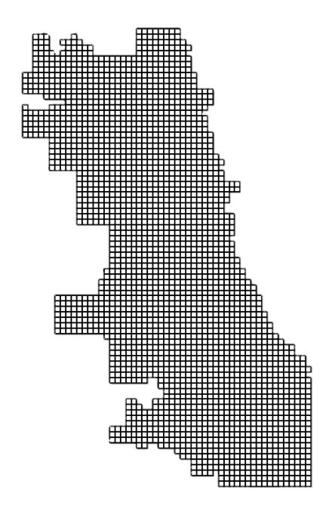
Predicting on a Grid
Chicago divided into 2500 cells
500m², or 2.5 city blocks
Prediction:
Number of failed inspections in each cell
Add to number of restaurants in each cell for projected inspections

Slide 6
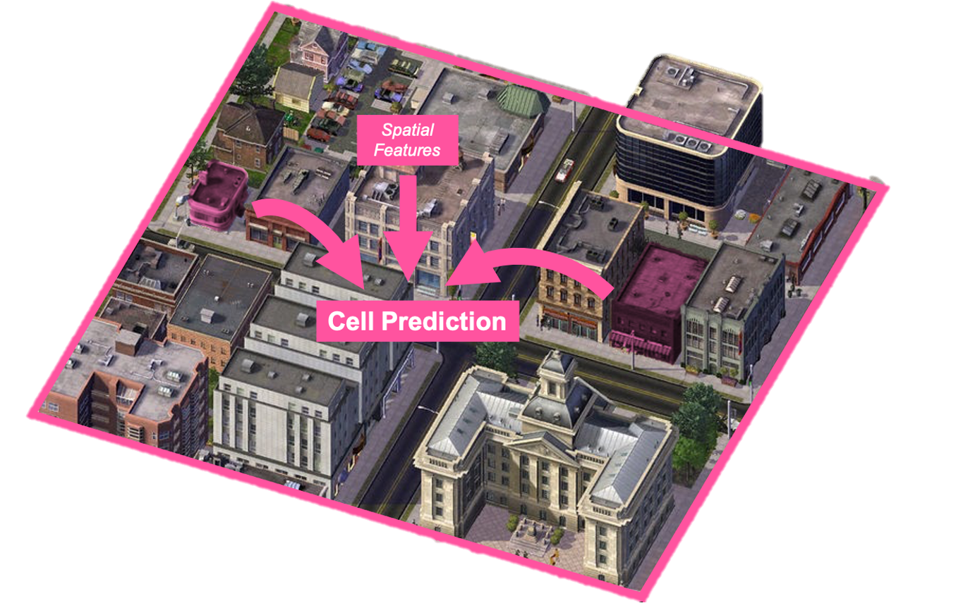
Why a Grid?
Better prediction for new establishments
Easy introduction of other spatial features

Slide 7


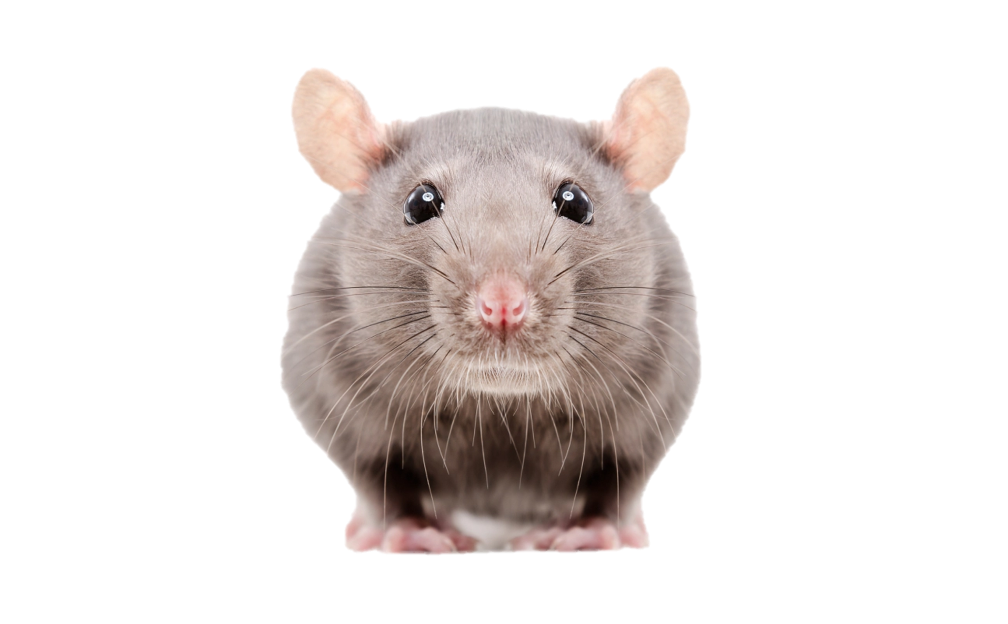
Risk Factors
Rodent Complaints (311 requests)
Sanitation (311 requests)
Ordinance Violation (Dept. of Buildings)
Graffiti (311 service requests for removal)
Liquor Retail (liquor store locations)
Previous Year Food inspections
Restaurant locations

Slide 8
Spatial Features: Nearest Neighbor
2
3.1 mi
3
0.4 mi
A
1.6 mi
Average Nearest Neighbor Distance: 1.7 mi
1
Notes:
Revise this slide, explain nearest neighbor function better,
Distance to loop, significant hotspots

Slide 9
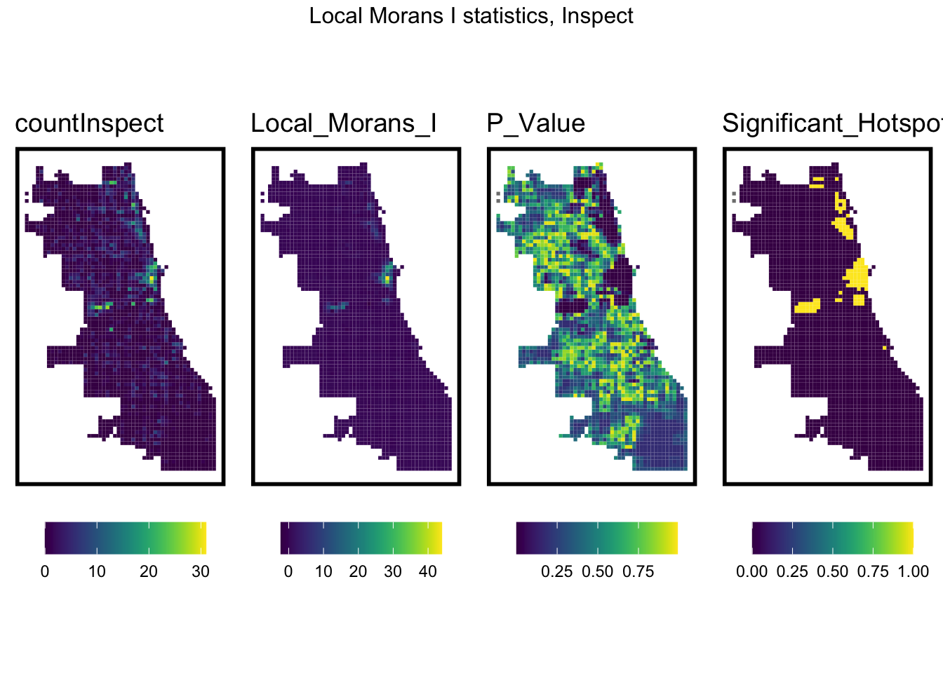
Significant Hotspots
Local Moran’s I

Slide 10
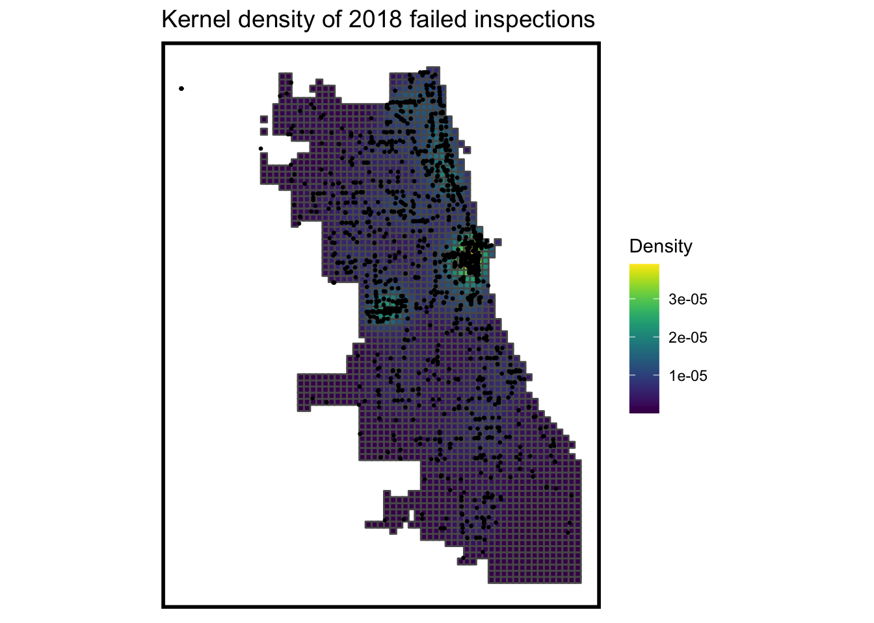
Predictions by Grid Cell

Slide 11
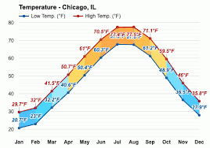
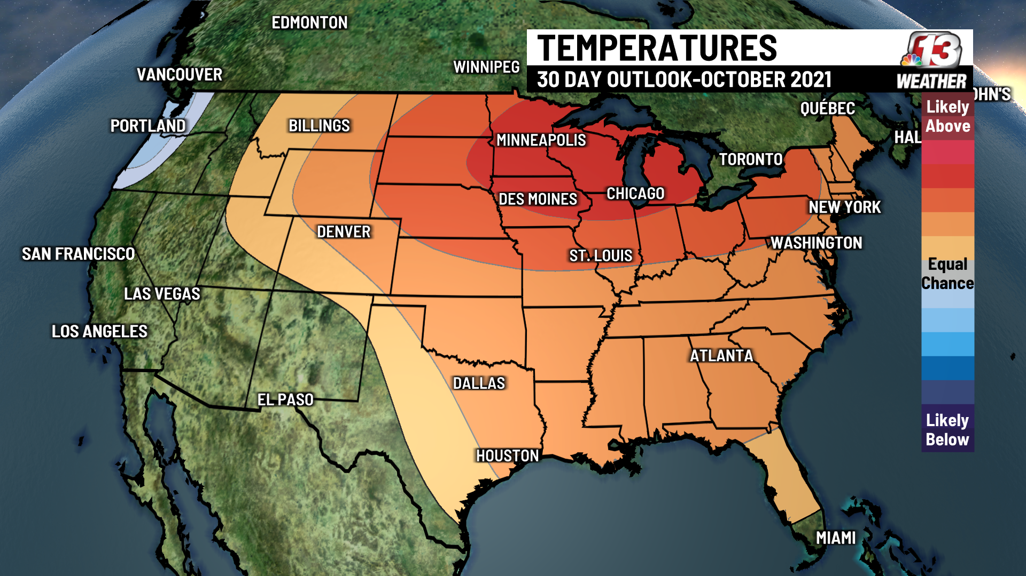
Extreme Weather Alert
3 consecutive days temperature above average: triggers sooner visits to high-risk areas

Slide 12
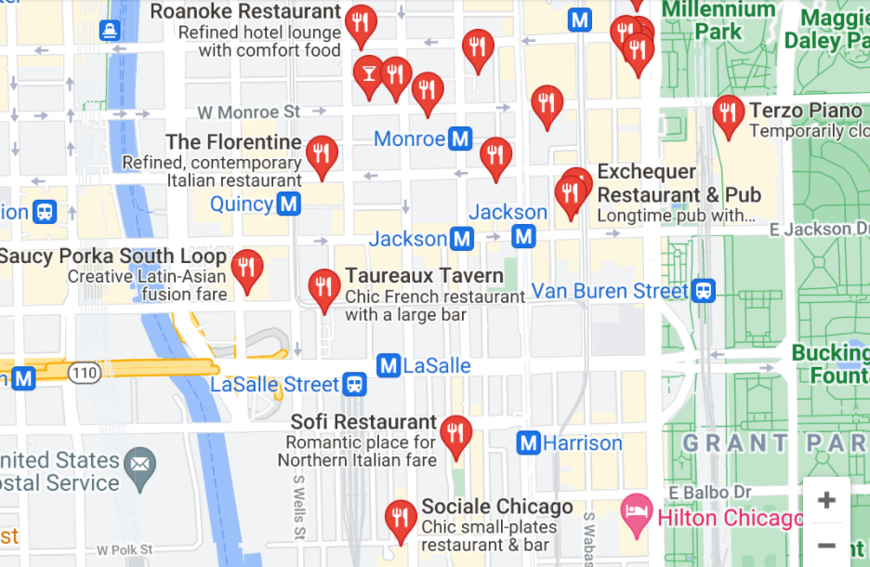
Scheduling Algorithm
3
Tiered system of prioritization
Daily inspector routes
Re-prioritization based on repeated 311 calls
Automatic triggers for extreme weather
2
1
34

Slide 13
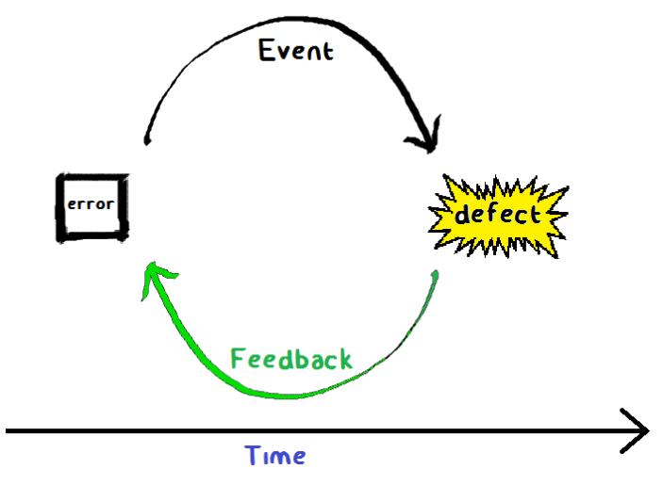
Conclusion
Efficient resource allocation
Shorten feedback loop to prevent critical failure
Increase consumer confidence
Property values

Slide 14
THE END

Slide 15
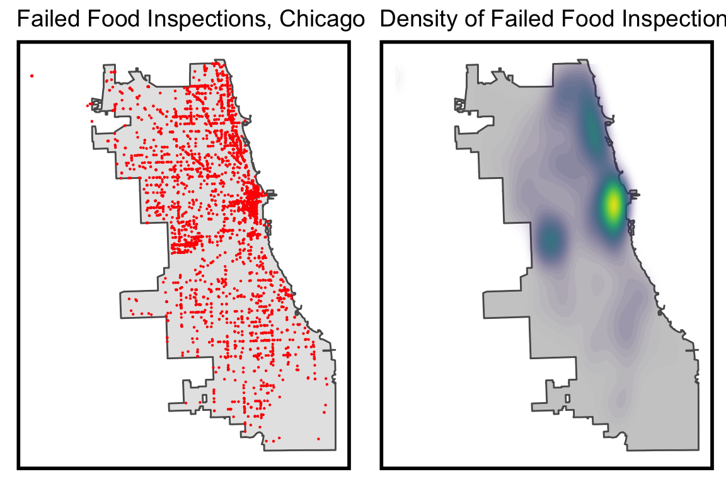
Restaurant Inspection Failures

Slide 16
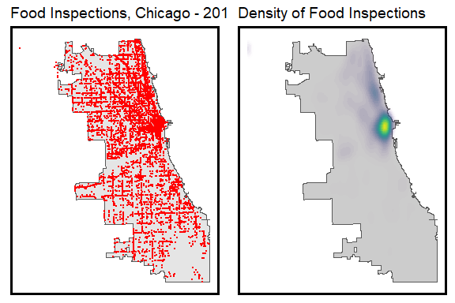
Food Inspections: All Restaurants

Slide 17
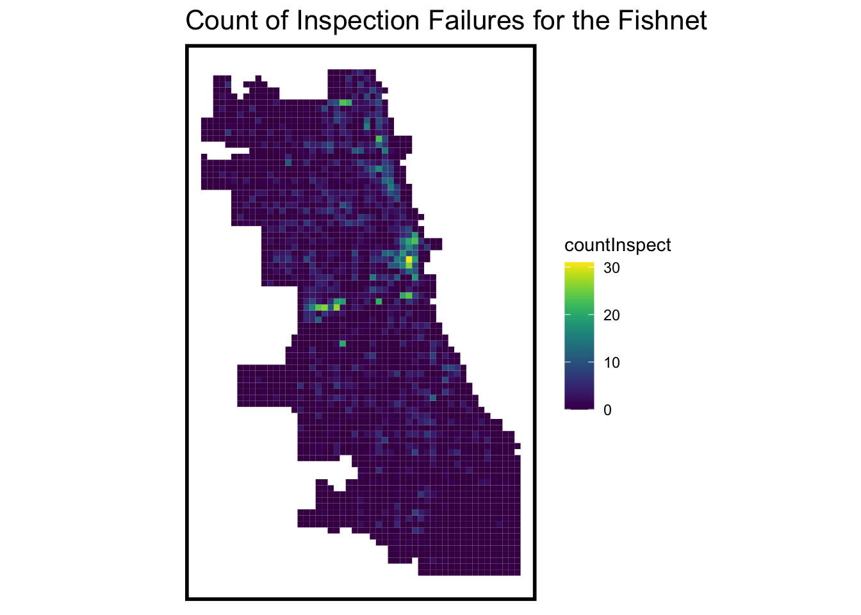
Failures by Fishnet

Slide 18
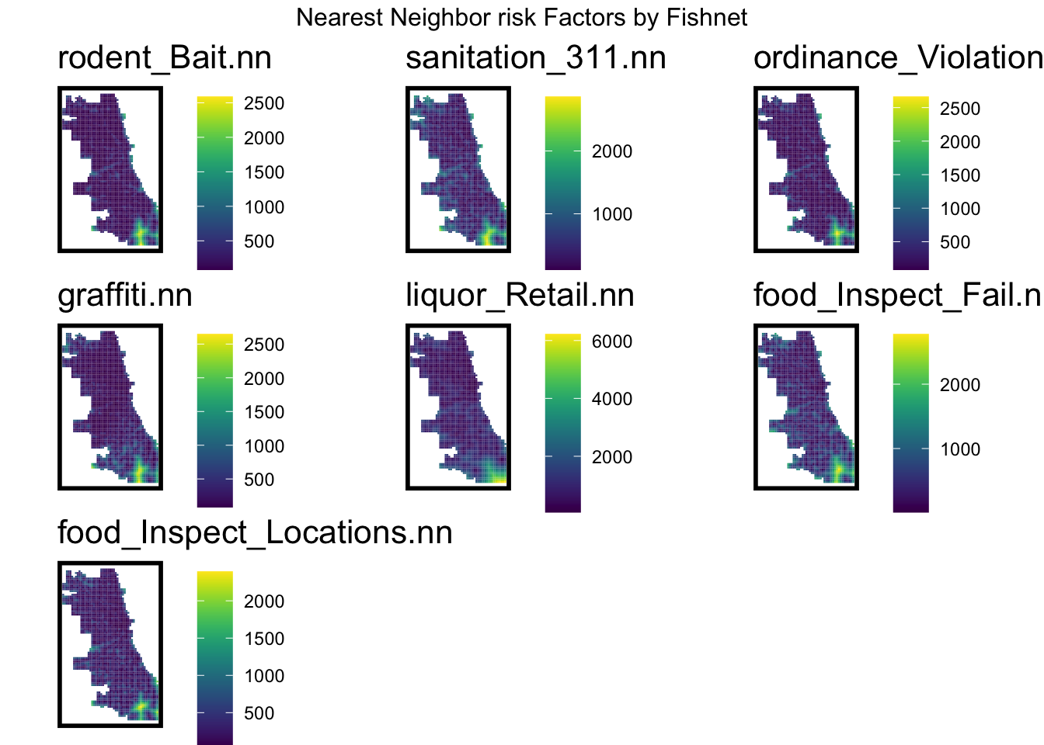
Prevention

Slide 19
Cost-Benefit

